Slide 1
Zapchat
The WolfPack
Sunil Yadav (001492711)
Kiran Panchal (001826692)
Rushabh Nisher (001400817)
Rajmanya Patekar (001492012)

Slide 2
About ZapChat
ZapChat is a chat application, that uses Firebase as a Real-time Database.
Firebase allows real-time synching of JSON data, and it also provides a flexible, expression-based rules language, called Firebase Realtime Database Security Rules. These rules ensure strong user-based security.

Slide 3
Use cases
A user can create a new account and signup.
A user can login from the login page.
A user can add new contacts to his contact list.
A user can send real-time messages.
A user can receive real-time messages.
A user can see the count of unread messages of a chat.

Slide 4
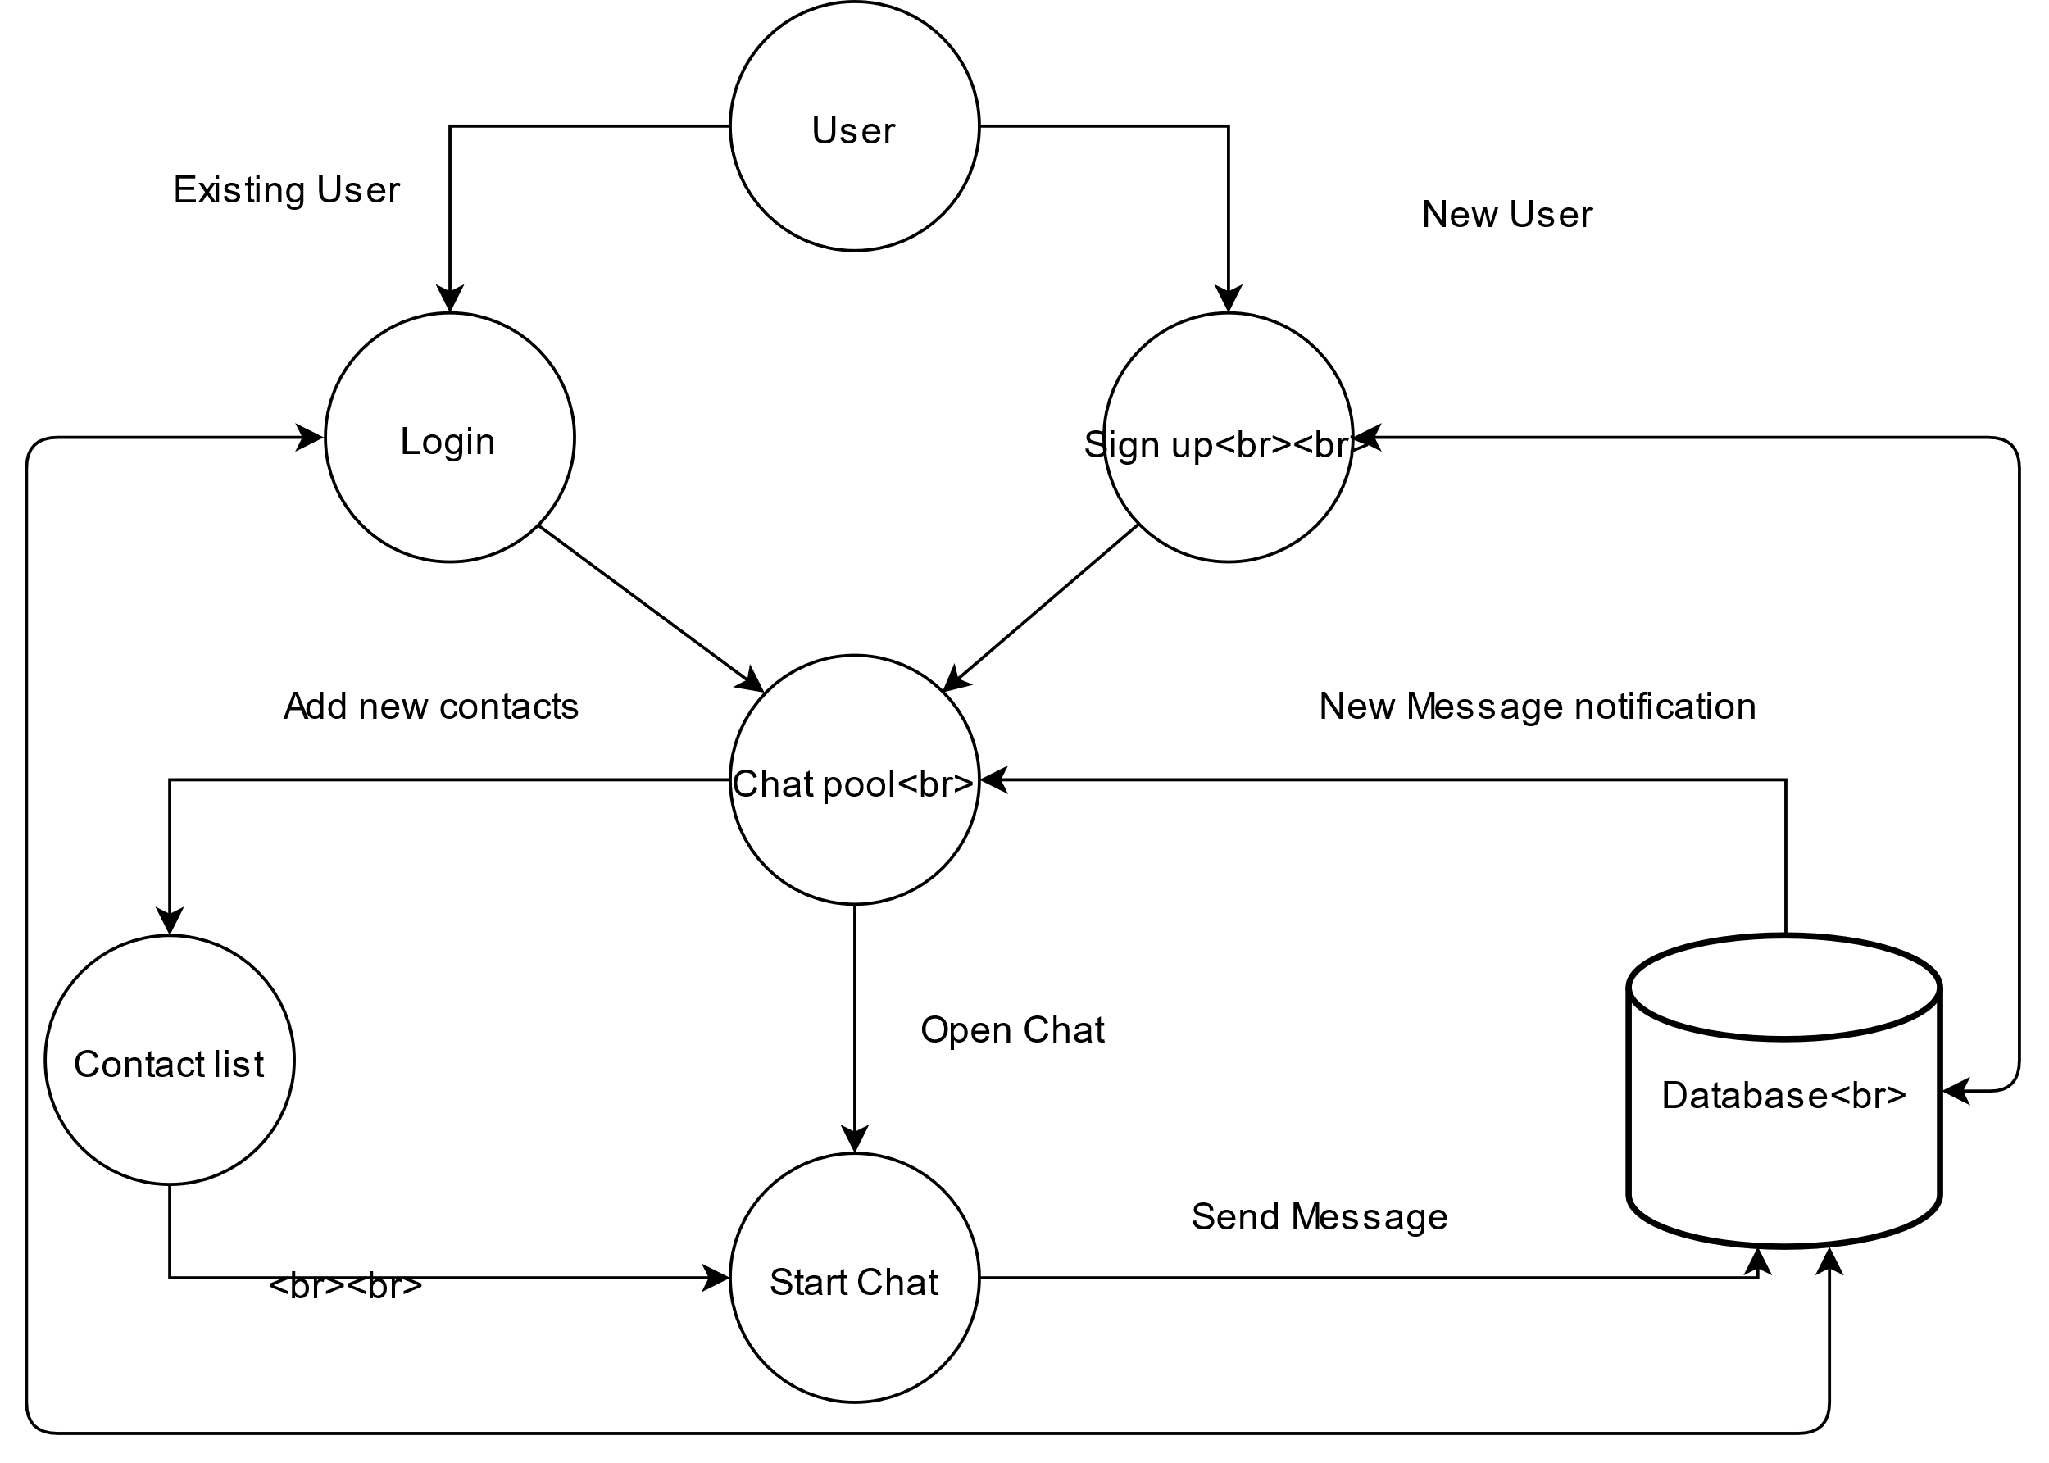
Our Domain Model

Slide 5
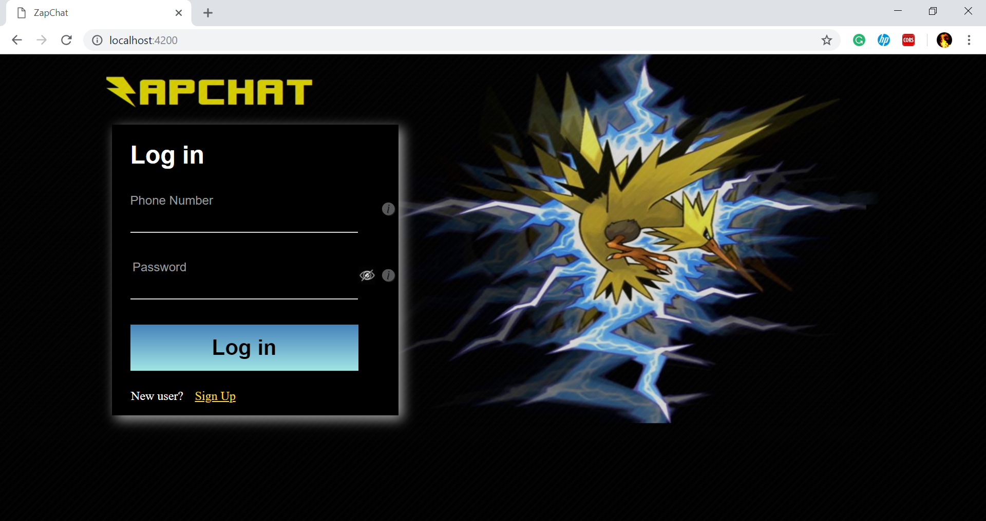
Login Screen

Slide 6
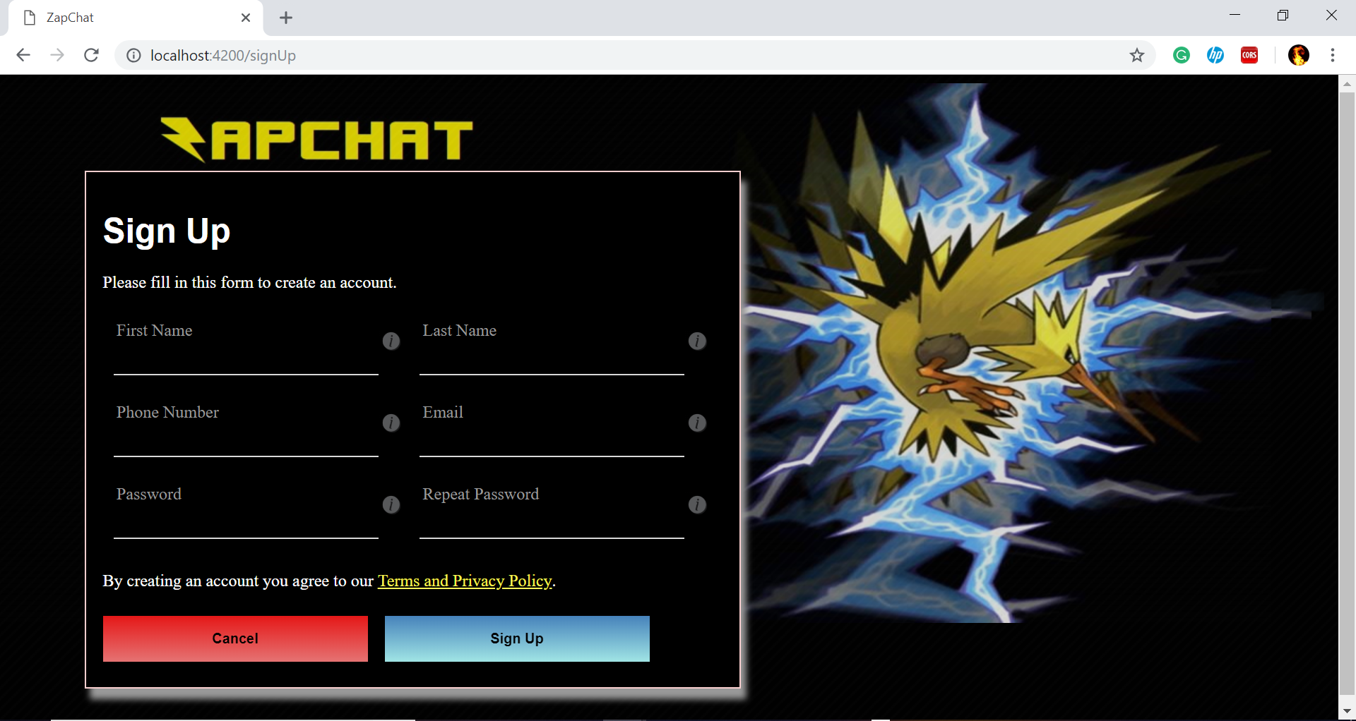
Sign-up Screen

Slide 7
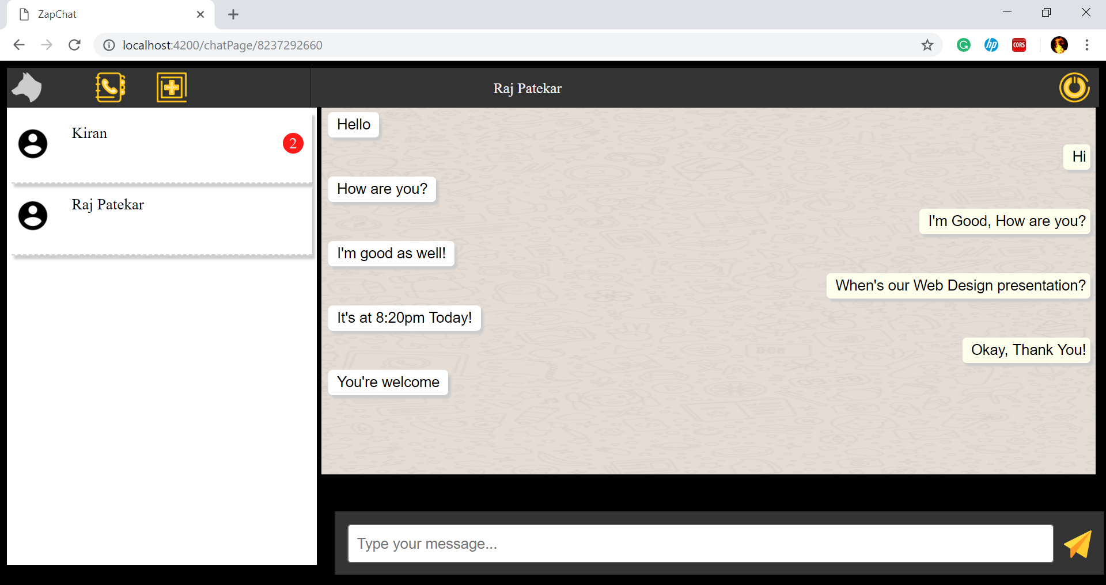
Main Chat Screen

Slide 8
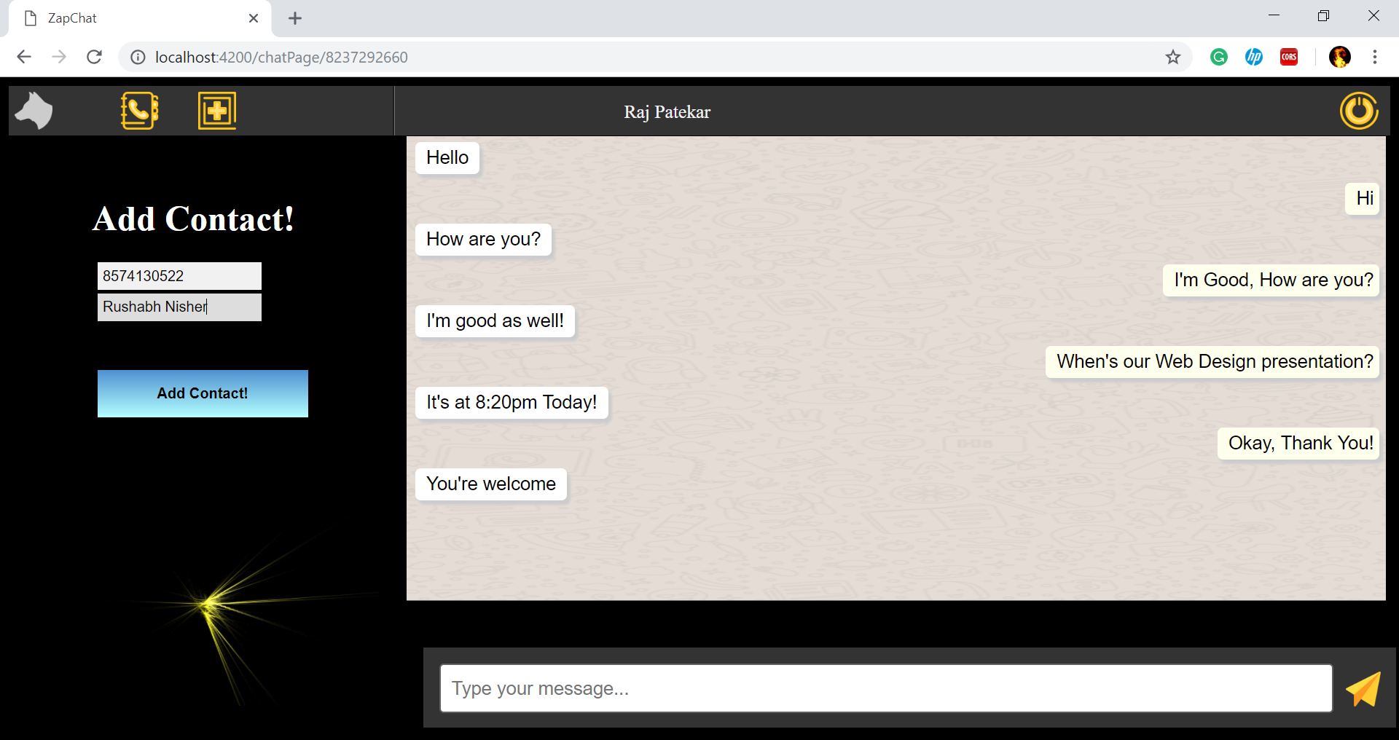
Add Contact Screen

Slide 9
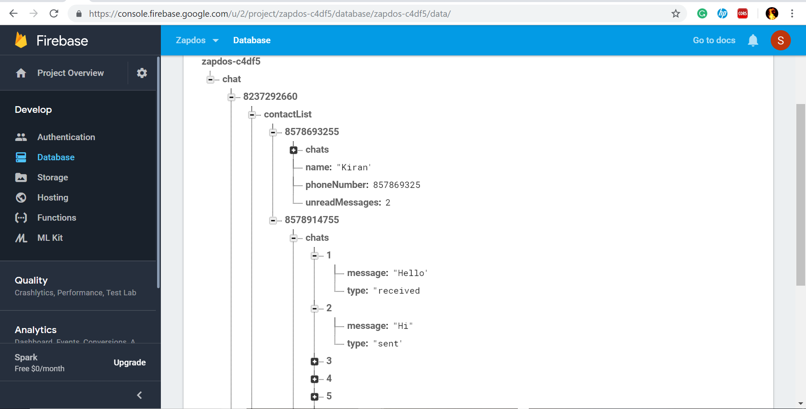
Firebase-Database Structure

Slide 10
Thank You!
Team
The WolfPack

